Slide 1



Psychosocial Interventions in Dementia Care
Eamon O’Shea
NUI Galway

Slide 2
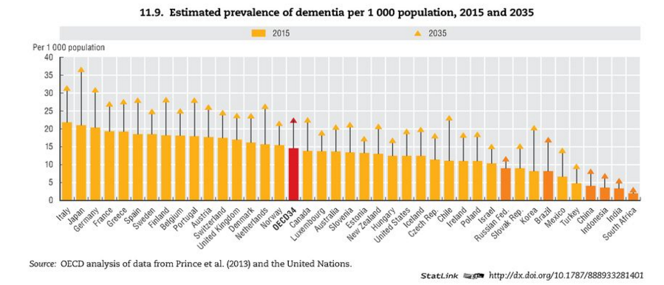
Dementia Prevalence Rates

Slide 3
Dementia Worldwide
An estimated 47 million people live with dementia in 2015 worldwide
The worldwide economic cost of dementia was an estimated US$808 billion in 2015
Less than 20% of these costs are attributable to direct medical care
Informal care is the main cost source – 40% to 60%

Slide 4
Dementia in Ireland
There are currently an estimated 55,000 people with dementia in Ireland
  Rising to 94,000 in 2031
  Rising to 152,000 in 2046
Average cost per person with dementia estimated at €40,500 in Ireland
Total burden an estimated €1.9 billion
Acute care additional costs estimated at €0.2 billion
Informal care accounts for 50% of overall costs of care

Slide 5
Drivers of Expenditure in Dementia Care
Population ageing is the main driver of demand for long-term care. We are living 2 years longer every decade
Informal care and residential care driving costs
Higher costs at end-of-life than other diseases like cancer or heart disease
Family sizes are declining, while female workforce participation is increasing leading to a potential decline in the availability of informal carers

Slide 6
Prevention- Mitigating Risk Factors
Cardiovascular (hypertension, obesity, diabetes, atrial fibrillation)
Physical activity
Depression
Traumatic brain injury
Sleep quality
Dementia prevalence rising but incidence may be flattening/declining

Slide 7
Balance of Care
The majority of people with dementia live in their own homes in the community - mainly undiagnosed
Most people wish to remain living in their own homes for as long as possible and practicable
Two thirds plus of all expenditure on dementia occurs in residential care settings
Variation in the balance of resources invested in nursing home care and community-based care often determines where care for older people is provided
Community care equals family care; residential care maximises public funding potential

Slide 8
What Do We Know?
People with dementia have a strong preference towards remaining at home in their communities
The current provision of formal care in the community is fragmented, and often lacks the flexibility and specificity to address the changing needs of people with dementia
Providing appropriate support to carers can reduce caregiver burden and enhance the family commitment to caring
Measurement of value in dementia care is poor
Prevention matters
Models of care matter

Slide 9
Biological Model
Biological model presents a clinical perspective
“Dementia as a clinical syndrome is characterised by global cognitive impairment, which represents a decline from previous level of functioning, and is associated with impairment in functional abilities and, in many cases, behavioural and psychiatric disturbances,” (NICE Mental Health Guidelines, 2007)
Person with dementia as patient to be treated
Necessary but not sufficient

Slide 10
Personhood in dementia
Dewing “personhood can be understood as the attributes possessed by human beings that makes them a person”
Kitwood defines this through relationships “a standing or status that is bestowed upon one human being by others, in the context of relationship and social being”
Notes:
What is personhood in dementia?

Slide 11
Citizenship
Citizenship is traditionally defined in the social science literature as a “status bestowed on those who are full members of a community. All who possess the status are equal with respect to the rights and duties which the status bestows,” (Marshall)
A citizen is defined by the acquisition of, and participation or inclusion in, the country or community in which they live, (Gould)

Slide 12
Social Model of Dementia
“The social model of care seeks to understand the emotions and behaviours of the person with dementia by placing him or her within the context of his or her social circumstances and biography. By learning about each person with dementia as an individual, with his or her own history and background, care and support can be designed to be more appropriate to individual needs,” (NICE Mental Health Guidelines, 2007)

Slide 13
Biopsychosocial Model
Spector and Orrell (2010) argue the need for a pragmatic, user-friendly model of care which takes into account the biological, psychological and social aspects of dementia.
Biological factors are defined as:
    Age, health prior to dementia, genetic factors, physical health, sensory impairment
Psychosocial factors include:
    Education/IQ, mental stimulation, mood, reaction to life events, previous life events, personality traits, environment, social psychology, personal psychology
Biopsychosocial approach needed to understand the factors influencing context and dynamic of impairment in dementia
Evidence base for psychosocial interventions for people with dementia is evolving but much to do

Slide 14
Psychosocial Theoretical Foundations
Rooted in personhood/person centredness, autonomy, dignity, respect, communication, understanding dementia processes and symptoms
Concerned with human interactive behaviour between providers/families and the person with dementia (PWD)
Reciprocity and integration mediated within a social context

Slide 15
History
Relatively new – origins in 1960’s and Reality Orientation work
But few studies emerged pre-2000 – mostly small-scale, short-term, diverse, opportunistic and site-specific
Absence of theoretical frameworks
Difficulty of undertaking RCT’s – methodological issues – replication difficult
Absence of appropriate outcome measures
Inadequate research funding

Slide 16
Psychosocial Domains: American Psychiatric Association
Behavioral approaches – identify antecedents and consequences of problem behaviors and attempt to reduce the frequency of behaviors by making changes in the environment (e.g. regular toileting)
Stimulation-oriented – recreational activity, art, music or pet therapy – aim to maximize pleasurable activities
Emotion-oriented – supportive psychotherapy, reminiscence, validation therapy, sensory integration, simulated presence therapy
Cognition-oriented – focus on specific cognitive defects: reality orientation, cognitive retraining, skills training

Slide 17
Typical Outcomes
Quality of life person with dementia (QoL-AD scale)
DEMQOL
Activities of daily living (Bristol ADL)
Depression (Cornell scale for depression in dementia (CSDD))
Autobiographical memory (autobiographical memory interview (AMI(E))
Agitation ((Cohen-Mansfield agitation inventory (CMAI))
Anxiety (rating anxiety in dementia (RAID) and hospital anxiety and depression scale (HADS))
Caregiver burden (Zarit burden interview)
Personhood – the self

Slide 18
Psychosocial Guidelines Across Countries
Inclusion of psychosocial interventions in dementia guidelines across Europe is limited
Guidelines for psychosocial interventions found in only small number of countries
UK NICE guidelines had best methodological quality and included most recommendations (e.g. recommend the use of group Cognitive Stimulation Therapy for people with mild to moderate dementia, irrespective of drug treatments received).
Physical activity and carer interventions recommended most often across all guidelines
Even when guidelines exist physicians tend to recommend pharmacological interventions far more often

Slide 19
Focus on Reminiscence
Cochrane Review concluded that there was uncertainty in relation to the effectiveness of reminiscence therapy and called for more and better designed trials in the area
Five trials but in total only covered 144 participants
Inconclusive evidence on effectiveness
Some evidence of improvement in cognition and in mood, as well as decrease in caregiver strain
Recent work in Ireland on reminiscence – Structured education programme for staff in long-stay care settings (Int.Journal of Geriatric Psychiatry)

Slide 20
Effect estimates: intention to treat ( ITT) and per protocol (PP) analysis
 | ITT Estimated effect (95% confidence interval (CI)) | PP Estimated effect (95% confidence interval (CI))
Qol-AD resident score | 3.54 (-0.83, 7.90) | 5.22* (0.11, 10.34)
QoL-AD caregiver score | 1.14 (-0.35, 3.62) | 1.40 (-1.75, 4.55)
CMAI score | -3.35 (-8.10, 1.82) | -2.14 (-7.94, 3.67)
CSDD score | -1.33* (-3.04, -0.36) | -0.86 (-2.66, 0.93)
MZBI score – nurse | 0.97 (-1.13, 3.08) | 1.50 (-0.73, 3.74)
MZBI score –care assistant | 0.42 (-1.82, 2.67) | 0.86 (-1.22, 2.94)
* P < 0.05

Slide 21
Discussion
Large, robust trial showing potential of reminiscence in the treatment of those with dementia
Per protocol results on QoL-AD exceeded minimum clinically important difference of 4 points
Pragmatic nature of trial meant adherence to protocol not always or easily achieved
More trials required to determine if similar effects of reminiscence are found in similar populations in other countries

Slide 22
Emerging Consensus?
Biopsychosocial model
Citizenship and rights
Personhood and person-centred care
Awareness and reducing stigma
Pathways to care from diagnosis to end of life care
Prevention and brain health

Slide 23
The New Paradigm
Personhood not patient/client
Prevention as much as cure
Capabilities more than risk
Inclusion (citizenship) not exclusion
Social as important as biological
Biopsychosocial model

