Slide 1
Education and Development for the Third Act
Liz Early

Slide 2
Third Act
What is Third Act?

Slide 3
Third Act
Longevity Revolution
25-30 years of extra life
Babies born today will live to 120 years
Notes:
Equivalent of whole new adult lifetime

Slide 4
Longevity
Living the equivalent of a whole new adult lifetime
Gift of Time
Opportunity and Challenge

Slide 5
Life Expectancy
Today living significantly longer than our Grandparents
Life Expectancy Ireland
  1916 53 years
  2014 80.77 years
Fastest in Ireland than anywhere else in Europe
Notes:
22% pop lived in > 10 rooms
36% lived 1 bedroom tenements
81:1000 dead before 1st Birthday – Dublin 153:1000
Homogenous society - 0.7% born outside Ireland

Slide 6
Ireland Demographics
> 65 years
  2016 .620 million
  2030 .924 million
  2060 1.443 million

Slide 7
Demographics
Impact of Longevity on
  Society
  Politics
  Personal

Slide 8
Third Act Question ....
Since I have served the expectations of my culture, reproduced my species, become a socially productive citizen and taxpayer, what now?

Slide 9
Everyone who lives long enough will have a Third Age; not everyone will have a Third Act
Dr. Ed Kelly

Slide 10
The New Third Act
First Act | Formation, childhood adolescence, dependency Growing to adulthood (1-25 years)
Second Act | Development, independence, career planning & progression, Partnering, bringing up family , saving for later ( age 25 – 60/65)
Third Act | Transformation, second chance, new career after retirement. Time, space, opportunity for growth & development (age 55-80+)
Fourth Act | Pairing down, old age, facing increasing frailty, loss of acuity of senses, health or mind and facing the inevitable end of life

Slide 11
Third Act
Development Phase – with own significance
As different to the Second Act as the First Act is to the Second
Opportunity to shift the old paradigm of ageing

Slide 12
Task of Third Act
Opportunity for Spiritual enlargement / development
Finish up the task of finishing ourselves
                Jane Fonda
The lifelong project of becoming more nearly the whole person we were meant to be (Hollis J)

Slide 13
Third Act Potential
Presents a rich possibility for spiritual enlargement, for we are never going to have greater powers of choice, never have more lessons of history from which to learn, never possess more emotional resilience, more insight into what works for us and what does not, or a deeper, sometimes more desperate, conviction of the importance of getting our life back (Hollis, J. 2006)

Slide 14
Third Act Development
It is a journey across the most archaic, most daunting, most inviting sea of all – our own souls (Hollis, J)

Slide 15
Third Act
  Upward ascension of human spirit
Time of;
  Wisdom
  Wholeness
  Authenticity
              Jane Fonda 2011

Slide 16
Why Third Act Development?
Jesus is reported to have said in Gnostic Gospel of Thomas ‘if you bring forth what is within you, what you bring forth will save you. If you do not bring forth what is within you, what you do not bring forth will destroy you’

Slide 17
Transition to Third Act
Dr Ed Kelly the Third Act

Slide 18

Education and the Third Act

Slide 19
Education for the Third Act
Life Long Learning
Education for First and Second Act
Now education for Third Act

Slide 20
Benefits of Education
Enhanced health, wellbeing & quality of life
Gain in knowledge
Enhanced motivation & confidence
Better ability to cope & adjust to change
Maintenance of independence
Active social participation

Slide 21
Why Education for the Third Act?
Significant Educational gap between younger & older people today
Participation in Lifelong Learning associated with previous educational attainment & positive experience
Lower educational attainment places people at greatest risk of poverty, social exclusion & poorer health
Basic human right “everyone has the right to education” (UN 1948 2002)

Slide 22
Education Policy Context
World Health Organisation
United Nations
European Union – active in developing Life Long Learning
National
  White Paper on Adult Education. Referred to older people who might have specific educational needs
  Equality Authority – recommended removal of barriers to older persons access to education

Slide 23
Third Act Education Participation
Dearth of research about older persons’ education & learning preferences.
Factors that influence participation;
  Societal attitudes
  Organisation of educational provision
  Structural factors
  Personal factors
  Previous educational attainment

Slide 24
Education Developments for Third Act
Third Age Universities
Institutes of Lifelong Learning
ForAge 2012 – EU funded & supported . Promote & communicate experience of lifelong learning for older people to create higher standards

Slide 25
Educational Developments - Ireland
Ireland – Age & Opportunity provides 5 programmes
Go for Life
Bealtaine Festival
Creative Exchanges
Get Vocal
Ageing with Confidence

Slide 26

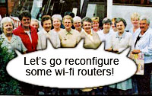
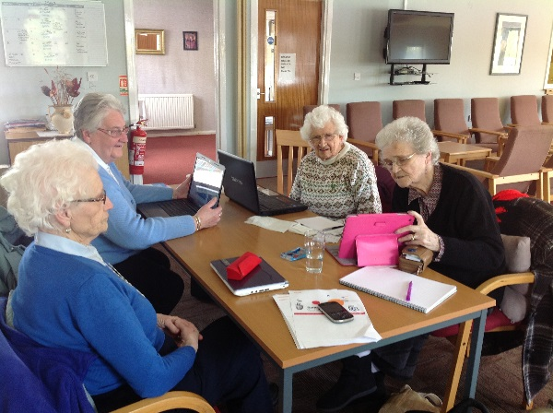

Slide 27
WHO; - when labour market, employment, education & social policies, & programmes support their full participation in socioeconomic, cultural & spiritual activities, according to basic human rights, capacities, needs & preferences people will continue to make productive contribution to society in both paid & unpaid activities as they age

Slide 28

Final Thought ...
‘Have the courage to follow your heart and intuition. They somehow already know what you truly want to become. Everything else is secondary’.
Steve Jobs 2005

Slide 29
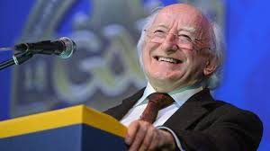
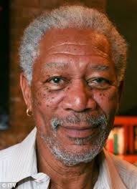
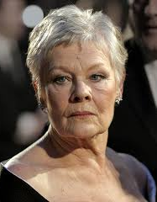
Third Actors

Slide 30
Fonda, J. (2011) The Third Act -U Tube
Hollis, J (2006) Finding Meaning in the Second Half of Life: How to finally, really Grow Up. Gotham Books USA
Westendorp, Rudi.(2015) Growing Older without Feeling Old: On Vitality and Ageing. Scribe London
www.thethirdact.ie

